Slide 1

UNIVERSITY INSTITUTE OF ENGINEERING
COMPUTER SCIENCE ENGINEERING
ARTIFICIAL INTELLIGENCE
(21CSH-611/621)
INTRODUCTION
DISCOVER . LEARN . EMPOWER

Slide 2
Uniform Cost Search (Branch&Bound)
QueueingFn is SortByCostSoFar
Cost from root to current node n is g(n)
Add operator costs along path
First goal found is least-cost solution
Space & time can be exponential because large subtrees with inexpensive steps may be explored before useful paths with costly steps
If costs are equal, time and space are O(b^{d})
Otherwise, complexity related to cost of optimal solution

Slide 3
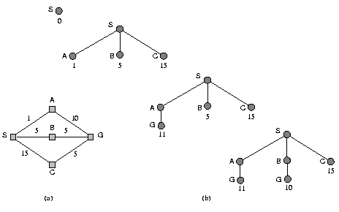
UCS Example

Slide 4
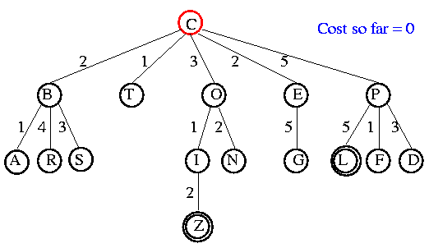
UCS Example
Open list: C

Slide 5
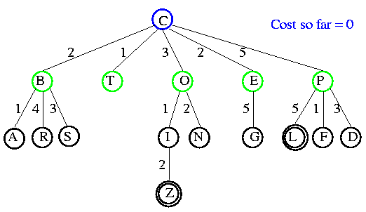
UCS Example
Open list: B(2) T(1) O(3) E(2) P(5)

Slide 6
UCS Example
Open list: T(1) B(2) E(2) O(3) P(5)

Slide 7
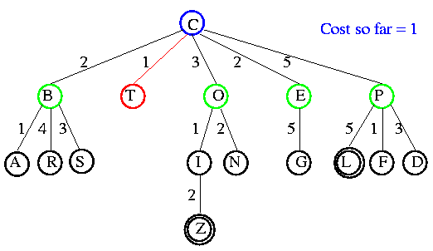
UCS Example
Open list: B(2) E(2) O(3) P(5)

Slide 8
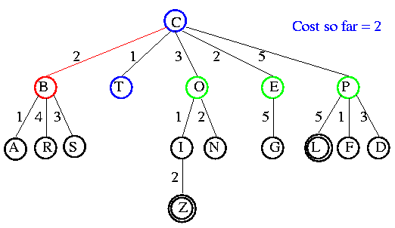
UCS Example
Open list: E(2) O(3) P(5)

Slide 9
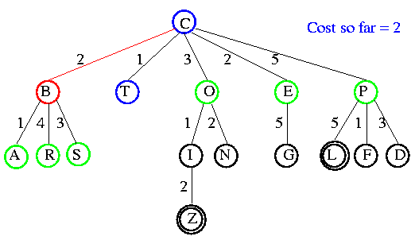
UCS Example
Open list: E(2) O(3) A(3) S(5) P(5) R(6)

Slide 10
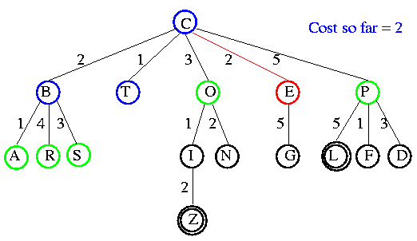
UCS Example
Open list: O(3) A(3) S(5) P(5) R(6)

Slide 11
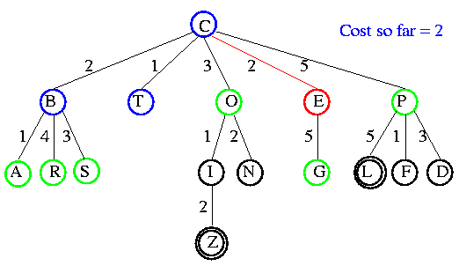
UCS Example
Open list: O(3) A(3) S(5) P(5) R(6) G(10)

Slide 12
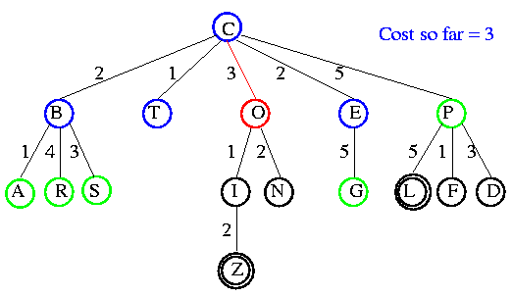
UCS Example
Open list: A(3) S(5) P(5) R(6) G(10)

Slide 13
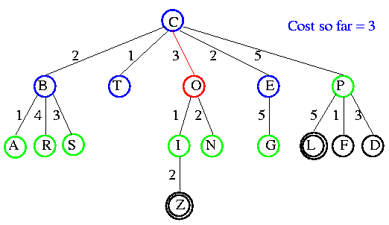
UCS Example
Open list: A(3) I(4) S(5) N(5) P(5) R(6) G(10)

Slide 14
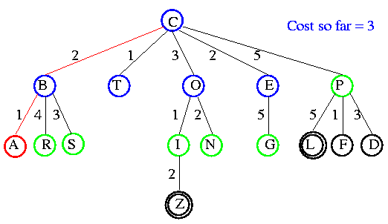
UCS Example
Open list: I(4) P(5) S(5) N(5) R(6) G(10)

Slide 15
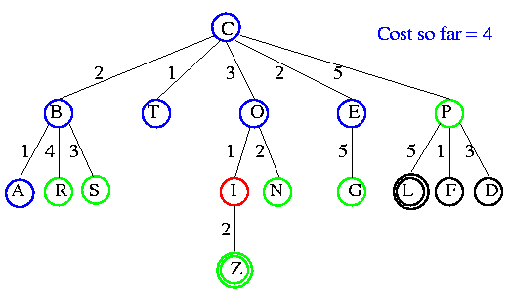
UCS Example
Open list: P(5) S(5) N(5) R(6) Z(6) G(10)

Slide 16
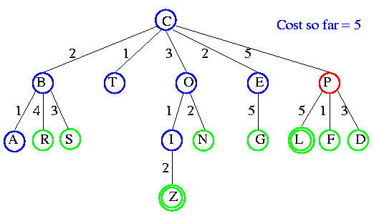
UCS Example
Open list: S(5) N(5) R(6) Z(6) F(6) D(8) G(10) L(10)

Slide 17
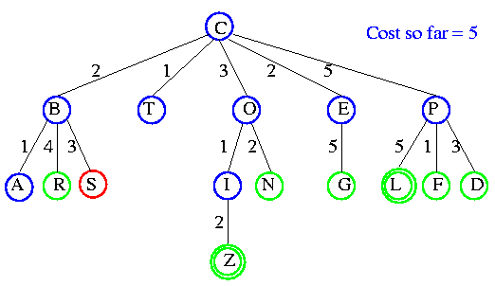
UCS Example
Open list: N(5) R(6) Z(6) F(6) D(8) G(10) L(10)

Slide 18
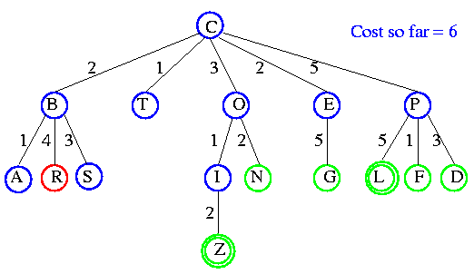
UCS Example
Open list: Z(6) F(6) D(8) G(10) L(10)

Slide 19
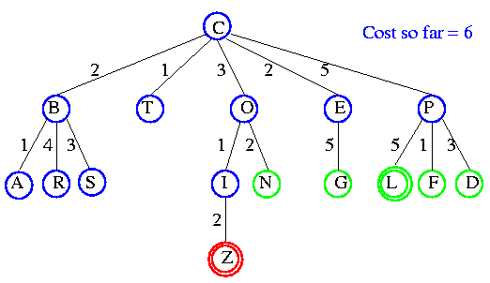
UCS Example
Open list: F(6) D(8) G(10) L(10)

Slide 20
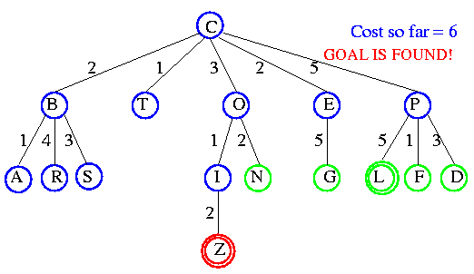
UCS Example

Slide 21

Comparison of Search Techniques
 | DFS | BFS | UCS
Complete | N | Y | Y
Optimal | N | N | Y
Heuristic | N | N | N
Time | b^{m} | b^{d+1} | b^{m}
Space | bm | b^{d+1} | b^{m}

Slide 22
Iterative Deepening Search
DFS with depth bound
QueuingFn is enqueue at front as with DFS
Expand(state) only returns children such that depth(child) <= threshold
This prevents search from going down infinite path
First threshold is 1
If do not find solution, increment threshold and repeat

Slide 23
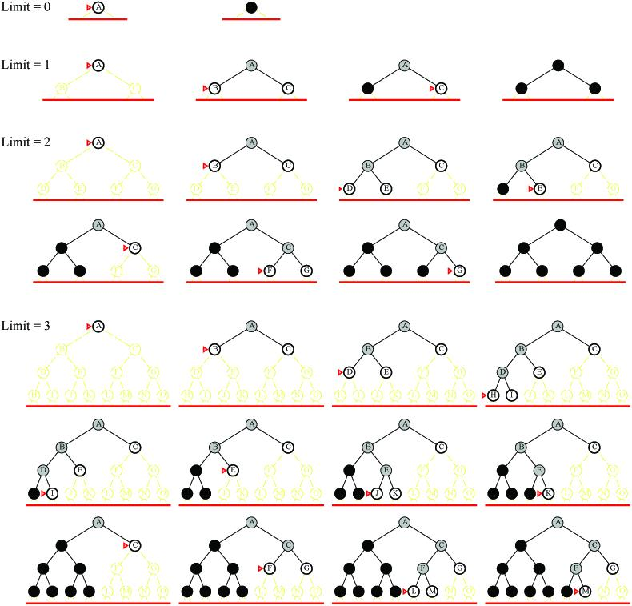
Examples

Slide 24
Analysis
What about the repeated work?
Time complexity (number of generated nodes)
[b] + [b + b²] + .. + [b + b² + .. + b^{d}]
(d)b + (d-1) b² ⁺ … + (1) b^{d}
O(b^{d})

Slide 25
Analysis
Repeated work is approximately 1/b of total work
Negligible
Example: b=10, d=5
N(BFS) = 1,111,100
N(IDS) = 123,450
Features
Shortest solution, not necessarily least cost
Is there a better way to decide threshold? (IDA*)

Slide 26
Comparison of Search Techniques
 | DFS | BFS | UCS | IDS
Complete | N | Y | Y | Y
Optimal | N | N | Y | N
Heuristic | N | N | N | N
Time | b^{m} | b^{d+1} | b^{m} | b^{d}
Space | bm | b^{d+1} | b^{m} | bd

Slide 27
THANK YOU

